Slide 1
Back end Development

Slide 2

Made By
Ahmed Mohamed Abubakr
Electronics engineer IC designer
Full stack web developer
Ambassador at TIEC-IA

Slide 3
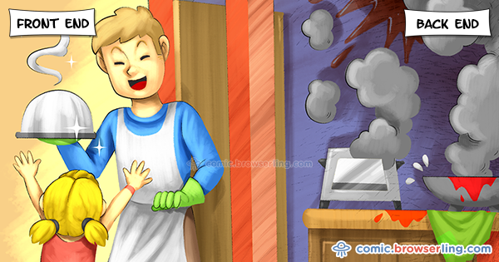

Slide 4
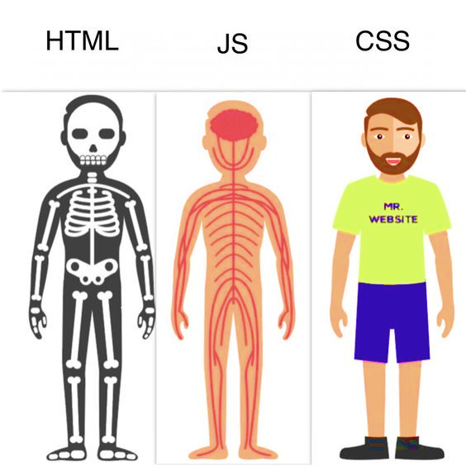

Slide 5
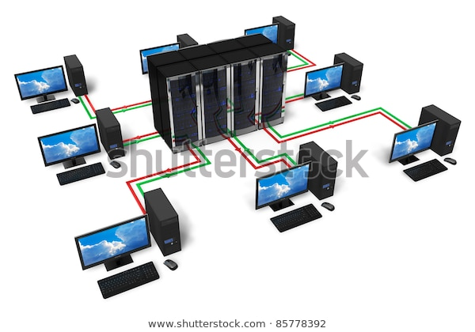

Slide 6
Back-end ?
What is websites and why we make it ?
What is the sections inside it ?
How I work ?
What do I need to start ?

Slide 7
Lets talk about PHP
Variables / Constants & datatypes
Conditional Statements
Loops
Arrays
Functions

Slide 8



Example
Create our first form with access

Slide 9
The End
in the end I hope you understood all I said contact on :
https://www.facebook.com/abobakr143
https://wa.me/201113284597

